Slide 1



Background
Problems
Introduction
Goals

Slide 2
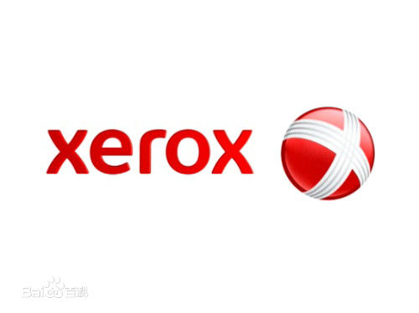
Background
1906
130
600

Slide 3
Problems
1999
1999：In 1999, Canon made a great success in the European and American market with a price less than 15% of Xerox.
2000：In 2000, Xerox found itself on the brink of bankruptcy and faced a series of problems.
2001：In 2001, the stock price of Xerox fell and fell, into a serious loss.

Slide 4
Goals
Build a new management team
Restore the company to profitability
Improve their market share

Slide 5
Baseline
Xerox 1998
Operating income
20 billions dollars
01
Assets
30 billions dollars
04
02
Profit
395 million dollars
Fortune Magazine 1999 Global 500
182th
03
Xu Weiwen

Slide 6

Baseline
Part 01
Stock price
Part 02
Revenue
Part 03
Net income and loss
Part 04
Debt
Xu Weiwen

Slide 7

Stock price
Falling
2000 The lowest price : $6.75 Average price : $8
Change
Conduct comprehensive management changes
Baseline
Knowledge management
2018 Stock price :$29
Xu Weiwen

Slide 8
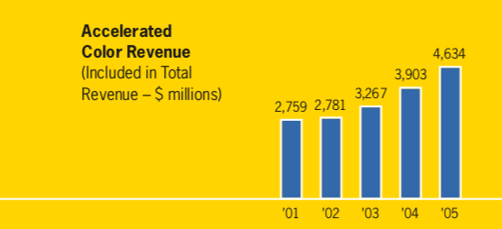
Revenue
October 24 2000 performance report
Third-quarter revenue begin to fall
After knowledge management
From 2001 to 2005
Baseline
Xu Weiwen

Slide 9
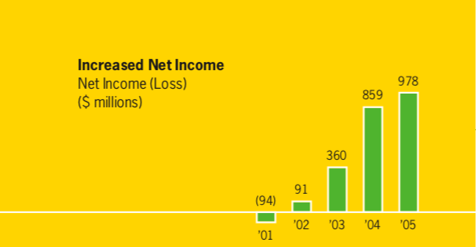
Net income and loss
The first half of 1999
Net income : $791 million
2000
The total loss : $273 million
After knowledge management
From 2001 to 2005
Baseline
Xu Weiwen

Slide 10
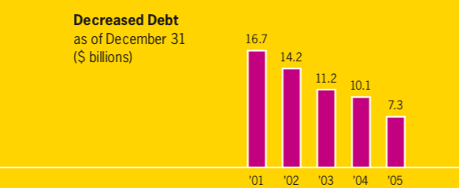
Debt
2000
Debt : 18 billion dollars
Market value : 8 billion dollars
After knowledge management
Form 2001 to 2005
Baseline
Xu Weiwen

Slide 11

Baseline
Share price
Confusing management
Revenue
Net income and loss
Debt
Xu Weiwen

Slide 12
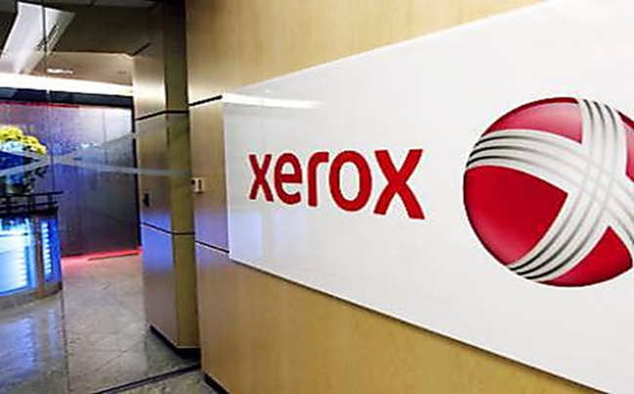
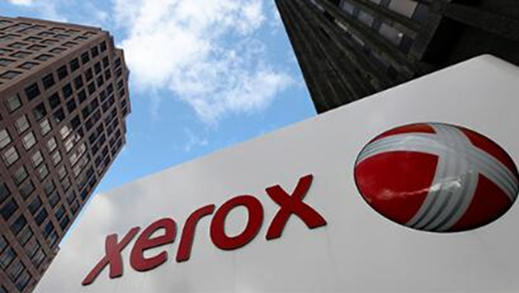
The Knowledge Management of Xerox
12
Student Name: OUYANG Zhuoran 18407218 ITM

Slide 13


Knowledge management requires enterprises to share knowledge, use collective wisdom to improve their adaptability and innovation ability, enable enterprises to respond quickly to external needs, and use the knowledge resources they have to predict the development direction and changes of the external market. In the era of knowledge economy, enterprises cannot be competitive without knowledge management.
13

Slide 14


14
Xerox established knowledge management system from a strategic perspective, showing the development strategy adopted by enterprises to meet the arrival of the knowledge economy, thus injecting new vitality and momentum into the competition and development of enterprises.
I will describe the knowledge management strategies of Xerox

Slide 15


The establishment of Knowledge Officer
The Knowledge Officer's main responsibilities:
Understand the company's environment and the company itself, understand the information needs of the company;
Establish and create an environment that can promote learning, accumulate knowledge and information sharing, so that everyone can realize the benefits of knowledge sharing, and to contribute to the company's knowledge base;
The quality, depth and style of knowledge base content are consistent with the company's development, including updating information, ensuring the normal operation of knowledge base facilities, strengthening knowledge integration, generating new knowledge and promoting knowledge sharing process.

Slide 16
Building enterprise intranet
Xerox has set up an intranet which mainly includes the following 6 aspects:
Work space: this is a virtual space where employees can share literature and ideas. This part of the content can be self-organized and self-maintained.
Products, Technology and Services: It preserves knowledge products, technology and service information of Xerox.
Knowledge Management News: It includes news, events, reports, speeches and announcements of various activities related to knowledge management.
Events: It stores information about knowledge management meetings, seminars and speeches.
Relevant Networks: Connect 15-20 sites related to knowledge management, including knowledge company sites, knowledge work and knowledge management sites.
Knowledge Collection: This knowledge base maintains knowledge management research data, development trends and best practices cases.

Slide 17


Building enterprise knowledge base
Xerox built the knowledge base inside the enterprise to realize the knowledge sharing inside the enterprise. The knowledge base is built on the enterprise's internal network. The system is composed of a set of software installed on the server. It can provide the required services as well as some basic security measures and network privilege control functions. Employees can use the system to read bulletins and find historical events, and meet with each other on the virtual company network. The system solves the problem of knowledge sharing inside the company.

Slide 18
The contents of the knowledge base include:
Company's human resources situation
Skills and evaluation methods needed for each position in the company
All information of the company's customers
Historical information of major events in the company's history
Internal information of departments and branches in the company
Details of the company's main competitors and partners
Research literature and research reports of internal researchers

Slide 19


19
Initiate research on Knowledge Innovation
(1). Support benchmark research projects conducted by the American Productivity and Quality Center.
(2). In-depth interviews with knowledge management workers from other organizations.
(3). Actively participate in the "knowledge management" activities organized by Emst & Young.

Slide 20
Knowledge management in different departments of the company
Knowledge management of sales department
In the past
Xerox salesmen usually worked for one customer for one year and then switched to other customers.
In this way, the company loses a lot of knowledge, because every time a business person is unfamiliar with the customer, it needs to start from scratch to understand the customer.
Now
Xerox has built a system on its Intranet. Salesmen store all the information they know about customers, especially about every transaction.

Slide 21


Knowledge management of maintenance department
In the past
The relevant knowledge of maintenance department is passed by manual.
But when the manual was worked out, it was outdated.
Now
Xerox's technicians have portable computers with high-performance hypertext document service functions for diagnosing and repairing machines. Xerox has also established a system in which maintenance personnel can store new problems or methods found in the work process in time to achieve knowledge sharing and timely updating.

Slide 22
CONTENTS
WANG Yuxiang
Part 01
Xerox’s Current Business Process Architecture
Part 02
The Xerox's Management Model
Part 03
The Advantage of New Management Model

Slide 23
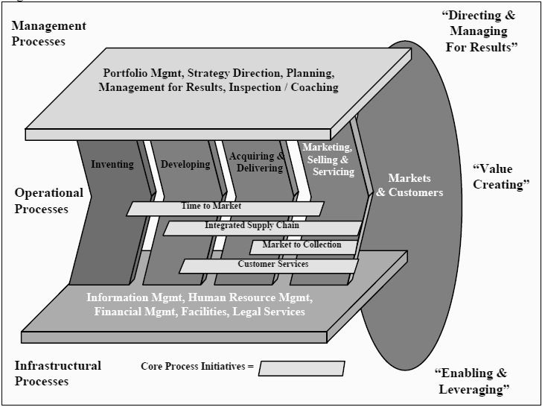
Part 01 Xerox’s Current Business Process Architecture
Basic structure in current situation
Problems in Xerox’s business management process
The company executives decided to optimize the Xerox business structure and rationally arrange human resources to improve the company's current situation.

Slide 24
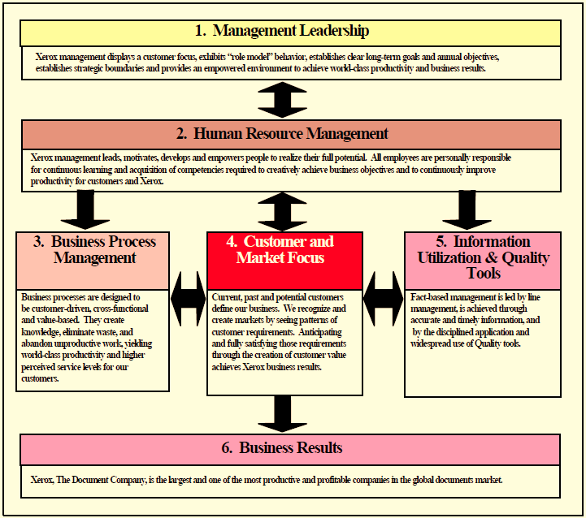
Part 02 The Xerox's Management Model
The framework puts human resources in a vital part and becomes a process directly managed by the company's leaders, and then based on the state of human resources to get an overview of other three parts.

Slide 25
Part 03 The Advantage of New Management Model
The model simplifies the operation of the business, it provides us with a logical framework to integrate and connect all activities and initiatives we need to manage.
The model enhances organizational efficiency. It uses human resources as the main aspect to control the entire company's business. Besides, it can make the company's personnel arrangement more reasonable and efficient, and reduce staff redundancy and improve work efficiency as much as possible.
The model focuses on implementation. The company often don't pay enough attention to implementation. This is a weakness. This model pay more attention to every status of the process and give response measures, and also make a reasonable distribution of the employees.

Slide 26
05
Comparison

Slide 27
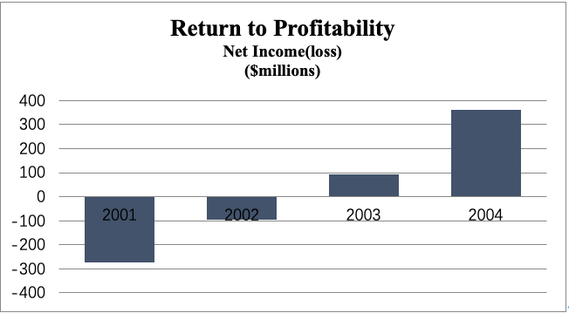

Slide 28
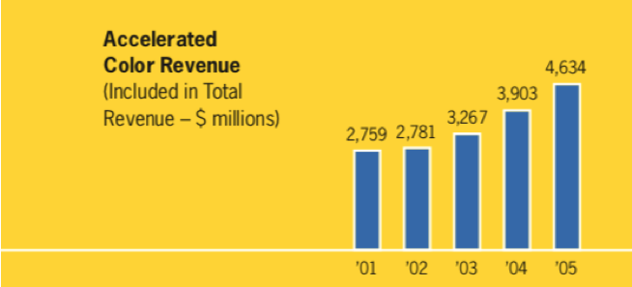

Slide 29
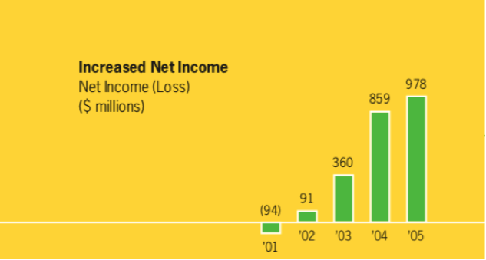

Slide 30
